Slide 1
Creakin’ Up with the Kardashians:
A study of creaky voice in gendered interactions
Team Wolfram
Amelia Tighe, Alaina Small, James Rice, Eliana Mugar, Chance Charley, Caroline Stemerman, Jessie Johnson
Notes:
Amelia

Slide 2
1.
Topic and overview
Notes:
Caroline - let’s do a brief overview of our topic

Slide 3
Topic
We want to see whether use of creaky voice varies when people of different genders interact with each other
Kim Kardashian’s creaky voice is ‘notorious’ (Time Magazine)
Kardashian has many public interactions with ‘Food God’ Jonathan Cheban to analyze
Notes:
Caroline
“We want to see whether people of different genders use creaky voice differently and if their use changes when people of different genders interact with each other. We have chosen to analyze Kim Kardashian, who, according to Time Magazine uses creaky voice *notoriously.* To compare Kim with a male speaker, we are also analyzing food god Jonathan Cheban because their public interactions provide many data samples. “

Slide 4
What is creaky voice?
Creaky voice
Also referred to as… glottal fry ; vocal fry
Characteristics of creaky voice:
Diminished energy
Low F₀
“Within words, it is most likely to occur at syllable boundaries”
Creaky voice as a sociolinguistic marker
Index certain personas/identities
Notes:
Caroline
“Creaky voice is also referred to as glottal fry or vocal fry. It occurs when the vocal folds are compressed tightly. We can recognize creaky voice because of the diminished airflow energy and low F-zero / fundamental frequency. It’s placement has some notable patterns:“Within words, it is most likely to occur at syllable boundaries” . Lastly, we also want to know if it can be used as a sociolinguistic marker to index certain personas/identities, which we will talk about more later in the presentation”

Slide 5
2.
Research Questions
Notes:
James

Slide 6
Research Questions
How does the production of creaky voice differ between Kim Kardashian and Jonathan Cheban?
How does their creaky voice use differ in isolation and interaction?
Notes:
James - We want to use these questions to draw conclusions about how men and women use creaky voice differently, how this use changes in group contexts, and how they use their voices to index identity characteristics and group memberships

Slide 7
3.
Review of the Research Literature
Notes:
Amelia

Slide 8
Creaky Voice: Interactional Effects in Production and Perception (Voorhees, 2021)
Focus group interviews w/ 7 first-year writing students & 1 PhD student (interviewer)
How creaky voice functions interactionally
Notes:
Amelia

Slide 9
Creak & Gender Identity (Voorhees, 2021)
Male speakers produce a significantly higher percentage of creak than female speakers
Males : filler words (“uh” “um”)
Females : response words (“yeah” “yes”)
Notes:
Amelia

Slide 10
Creak as a Turn-Taking Device (Voorhees, 2021)
Longer speech segment → more creak
Potential explanation: creak as a way to end speech segment & give their interlocutor an opportunity to speak
Notes:
Amelia

Slide 11
Creaky Voice: A New Feminine Voice Quality for Young Urban-Oriented Upwardly Mobile American Women? (Yuasa, 2010)
Shift from creaky voice being associated with men to women
Thought to be a symbol of authority/imitation of men in power
2010 perception study: creaky voice is seen as educated, informal, genuine, nonaggressive
Notes:
Caroline
This study from Yuasa in 2010 shows a different perspective from Voorhies. It describes a recent shift from creaky voice being associated with men to creaky voice being associated with women. According to Yuasa, women use creaky voice to imitate the men in power and gain prestige from this linguistic marker. A perception study found through a survey that creaky voice is seen as educated, informal, genuine, and non aggressive.”

Slide 12
Phonation type as a stylistic variable: The use of falsetto in constructing a persona (Podesva, 2007)
Use of phonation to index identity
Case study : Heath ; young, gay professional
Notes:
James

Slide 13
Diva Persona (Podesva, 2007)
‘an operatic prima donna’
‘By definition, a diva is a rampaging female ego redeemed only in part by a lovely voice’
‘usually a woman, who is characterized simultaneously by beauty (achieved through talent and/or appearance) and off-putting superiority’
Notes:
James

Slide 14
The Role of Lexical Stress on the Use of Vocal Fry in Young Adult Female Speakers (Gibson, 2017)
The role of lexical stress vs. linguistic and sociolinguistic triggers in creak production
“an exploration of the influence of lexical-level linguistic cues on the use of sociolinguistic cues”
Notes:
Amelia

Slide 15
Creak & Lexical Stress (Gibson, 2017)
Habitual vocal fry occurs more frequently on unstressed syllables
Possibly due to the fact that stressed syllables have higher amplitudes and F₀ & more regular vibratory patterns (competing with features of creak)
Notes:
Amelia

Slide 16
Habitual Use of Vocal Fry in Young Adult
Female Speakers (Wolk 2011)
Vocal fry used by more than ⅔ of female college student participants
“It is possible that these college students have either practiced or observed this vocal register and modeled it to match popular figures.”
Rarely used in sustained vowels
Most often used at the end of sentences
“The present findings are also in agreement with psycholinguistic research reporting the tendency to use vocal fry as a linguistic marker of paragraph and sentence boundaries.”
Notes:
Caroline-
“This study by Wolk from 2011 shows why many young women use creaky voice. In fact they found that over ⅔ of female college students use vocal fry. One reason proposed by Wolk is that the students have either observed or practiced this vocal register and modeled it to match popular figures. Here is some evidence that young women may adopt Kim’s creaky voice to imitate her prestige.
Some linguistic variables mentioned in this study are that creaky voice is rarely used in sustained vowels, which is different from Voorhies analysis that creak is more common in longer speech segments. We also see that creak is more often used at the end of sentences. “

Slide 17
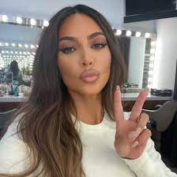
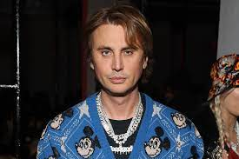
‘Participants’
Kim Kardashian
Female, 41 years old, American socialite and media personality, LA native
Jonathan Cheban
Male, 47 years old, American reality TV personality, born in the Soviet Union and living in LA
Notes:
Caroline

Slide 18
4.
Hypothesis and Predictions
Notes:
Amelia

Slide 19
Hypothesis: Social Effects
Kim Kardashian uses creaky voice to establish high-class female diva persona, Jonathan Cheban uses it in conjunction with her to gain acceptance in her social circle & proximity to her persona.
Notes:
Amelia

Slide 20
Hypothesis: Variation
We expect Kim to use more creaky voice than Jonathan when they are alone
We expect Jonathan’s creaky voice use to increase when they are together
We expect creak to appear more in longer segements, unstressed syllables, and in phrase final position
Notes:
Amelia

Slide 21
5.
Data and Methodology
Notes:
Caroline

Slide 22

Data Sources
7 audio clips with Kim Kardashian and Jonathan Cheban
2 videos of conversations together
3 recordings from Kardashian to online audience
2 recordings from Cheban to online audience
All performances in informal styles
Notes:
Caroline - we found these from their television interviews on KUWTK and from instagram lives where they are talking about a product to their audience

Slide 23
Methodology
Variables:
Speaker
Alone vs. together
Absence/presence of creak in a vowel per word
Stressed/unstressed syllable
Vowel length
Phrase-final
Notes:
Amelia

Slide 24
6.
Findings

Slide 25
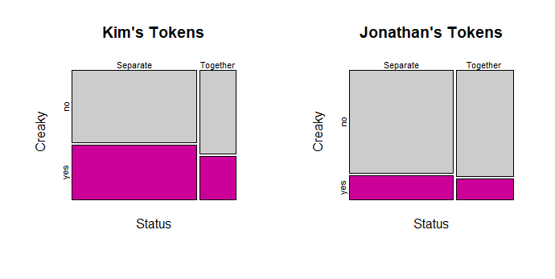
Token Summary
Notes:
Amelia

Slide 26
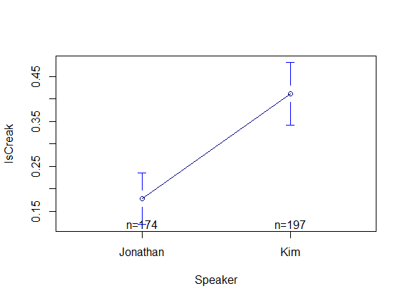
Creaky tokens by Speaker
Kim vs. Jonathan:
***p<.0001
Notes:
Amelia

Slide 27
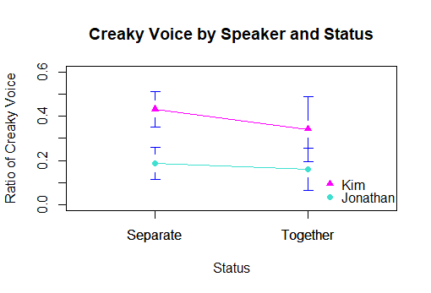
Do they change in different contexts?
Together vs. Separate:
p>.1
Not significant for either speaker
Notes:
Amelia

Slide 28
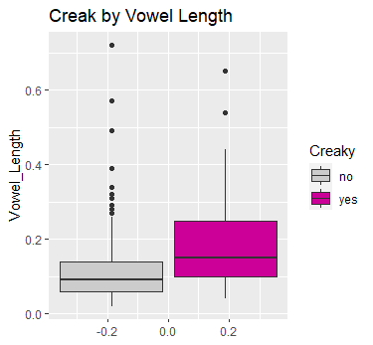
How does vowel length affect creaky voice?
***p<6.79e-07
Notes:
Amelia

Slide 29
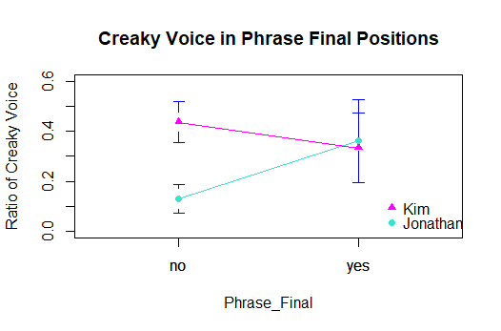
How is creaky voice used in phrase-final positions?
Speaker interaction:
**p=0.00955
Notes:
Amelia

Slide 30
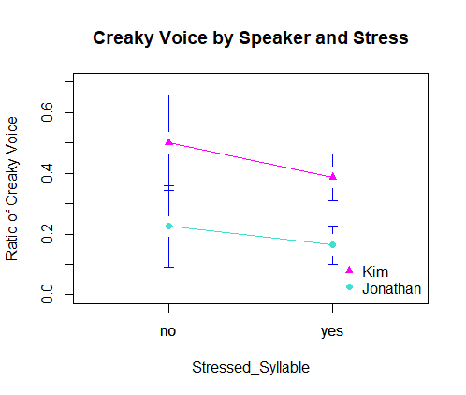
How does stress affect creaky voice use?
Stress effect:
* p=0.04814
Notes:
Amelia

Slide 31
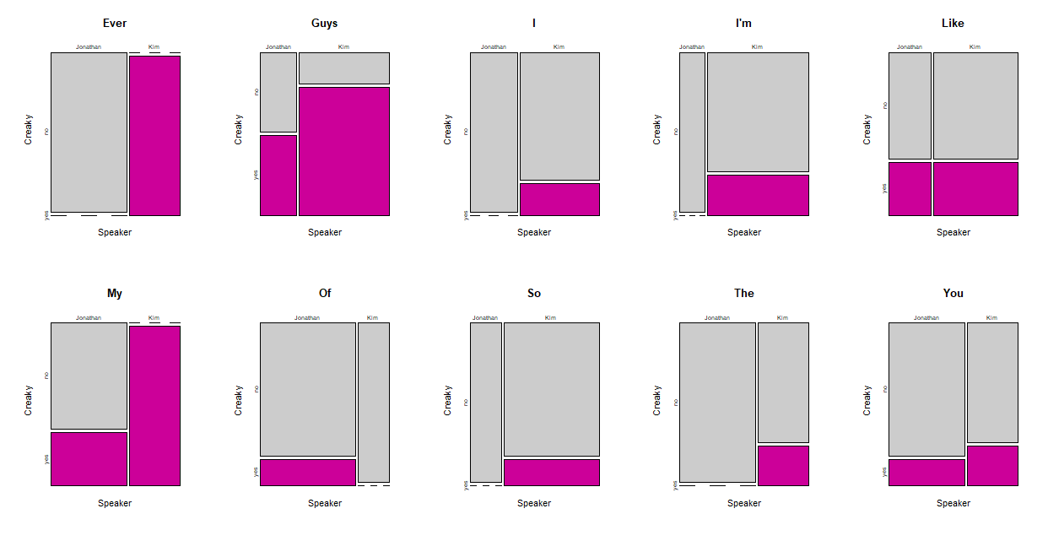
Interact Variation: Top 10 Words
Notes:
Amelia - All of these words were used at least 5 times
Visualization of how some words creak more than others

Slide 32
7.
Conclusions and Implications
Notes:
James

Slide 33
Was our hypothesis correct?
As expected, Kim used more creaky voice than Jonathan in all environments
Contrary to our hypothesis, Jonathan’s creaky voice did not increase when they were together
As expected creak appeared more in longer vowels
Jonathan matched expected phrase-final patterns, but Kim did not
Notes:
James

Slide 34
Results interpretation
Creaky voice related to expressiveness (Podesva)
Associated with cosmopolitan femininity (Yuasa)
Lack of correlation between separate/together environments shows the prevailing broader feminine social meaning overrides any situational likening of John to Kim.
Notes:
James

Slide 35
Results Interpretation
Kim’s diva persona manifests as an interactional role (Bucholtz & Hall via Podesva), not as community standard?
John has no reason to position himself in any way in reference to this role through his usage of creak
Notes:
James

Slide 36
Limitations
Audio quality
Inherent performativity of celebrity
Narrow case study
Impressionistic coding
Notes:
Amelia

Slide 37
Further Research
Social meaning of creak (in broader environments)
Is it used more in formal or informal settings?
Does use of creak change when gender and/or sex are the same between two people?
Study with more speakers who are not performing
Notes:
James

Slide 38
8.
References

Slide 39
References
​​Gibson, T. A. (2017). The Role of Lexical Stress on the Use of Vocal Fry in Young Adult Female Speakers. Journal of Voice, 31(1), 62–66. https://doi.org/10.1016/j.jvoice.2016.02.005
Heid, M. (2017, November 02). What Is Vocal Fry and Creaky Voice? Retrieved from https://time.com/5006345/what-is-vocal-fry/
Podesva, R. J. (2007). Phonation type as a stylistic variable: The use of falsetto in constructing a persona. Journal of Sociolinguistics, 11(4), 478–504. https://doi.org/10.1111/j.1467-9841.2007.00334.x
Voorhees, Victoria Anita. (2021). "Creaky Voice: Interactional Effects in Production and Perception. " Master's Thesis, University of Tennessee, 2021. https://trace.tennessee.edu/utk_gradthes/6186
Wolk, L., Abdelli-Beruh, N. B., & Slavin, D. (2012). Habitual Use of Vocal Fry in Young Adult Female Speakers. Journal of Voice, 26(3), e111–e116. https://doi.org/10.1016/j.jvoice.2011.04.007
Yuasa, I. P. (2010). Creaky Voice: A New Feminine Voice Quality For Young Urban-Oriented Upwardly Mobile American Women? American Speech, 85(3), 315–337. https://doi.org/10.1215/00031283-2010-018

Slide 40
Thank you for listening!!!

